Slide 1

Sina Lalehbakhsh
Django Backend Engineer
Data • Performance • Scalability

Slide 2
Professional Summary
Backend engineer specialized in Django and FastAPI, focused on buildingscalable, secure, and high-performance data-driven systems.
Experienced in ORM optimization, asynchronous processing, databaseperformance tuning, and production-ready backend architecture.

Slide 3
Core skills: Django Foundations
Core skills: Backend Engineering
Advanced Django ORM (query optimization, annotations, prefetch/select related)
Security best practices (auth, permissions, SQL injection prevention)
Async & concurrency (async views, background tasks, Celery concepts)
Django REST Framework & API design
FastAPI for high-performance async APIs

Slide 4
My career journey
2010 – 2020
2020– present
2021 – present
• Python fundamentals & programming basics
• Python, Django, Git, Linux, Docker, Bash
• Backend system design & DevOps fundamentals
• Professional GitHub presence
• Open-source & production-ready backend projects

Slide 5
Programming Languages
Python – Focus on Django
Go – Focus on building CLI tools
BASH – for linux
Javascript – for web and Penetration testing

Slide 6
Languages
Persian - Farsi
English
Germany – Deutsch Sprechen

Slide 7
Core skills: Django Foundations
Python
Django / FastAPI
PostgreSQL
Redis
Docker & Docker Compose
Pytest
Linux

Slide 8
Deploy & DevOps
Deploy & DevOps
Docker & Docker Compose (multi-service architecture)
Environment-based configuration
CI-ready containerized applications
Production tuning and reverse proxy setup (Nginx)
Backup and recovery strategies

Slide 9
Database Management
Indexing
Complex Migrations
Connection Pooling
Multi-DB
Transactions

Slide 10

Performance Optimization
Performance Optimization
ORM query profiling & optimization
Caching strategies (Redis, per-view, low-level cache)
Async endpoints for I/O-bound tasks
Pagination strategies for large datasets
Lazy vs Eager loading

Slide 11
Monitoring & Debugging
Slow Queries
APM Tools
Structured Logging
Metrics
Health Checks

Slide 12
Large Scale Data
Efficient Pagination
Bulk Operations
Background Tasks
Cron Jobs
Window Functions

Slide 13
Scalability
Stateless Design
Message Queues
Caching Patterns
Read Replicas
Sharding

Slide 14
Data Security
SQL Injection Prevention
Encryption
Rate Limiting
API Security
Audit Logs

Slide 15
Testing & Quality
Testing & Quality
Unit & integration testing with pytest
Database & ORM tests
API testing
Load & performance testing basics
CI pipeline readiness

Slide 16
Data & Analytics
Analytical APIs
Aggregations
Materialized Views
Data Export
Analytics Integration

Slide 17
Side skills
JavaScript (fundamentals)
React (basic integration)
Grafana & monitoring tools
ELK stack familiarity

Slide 18
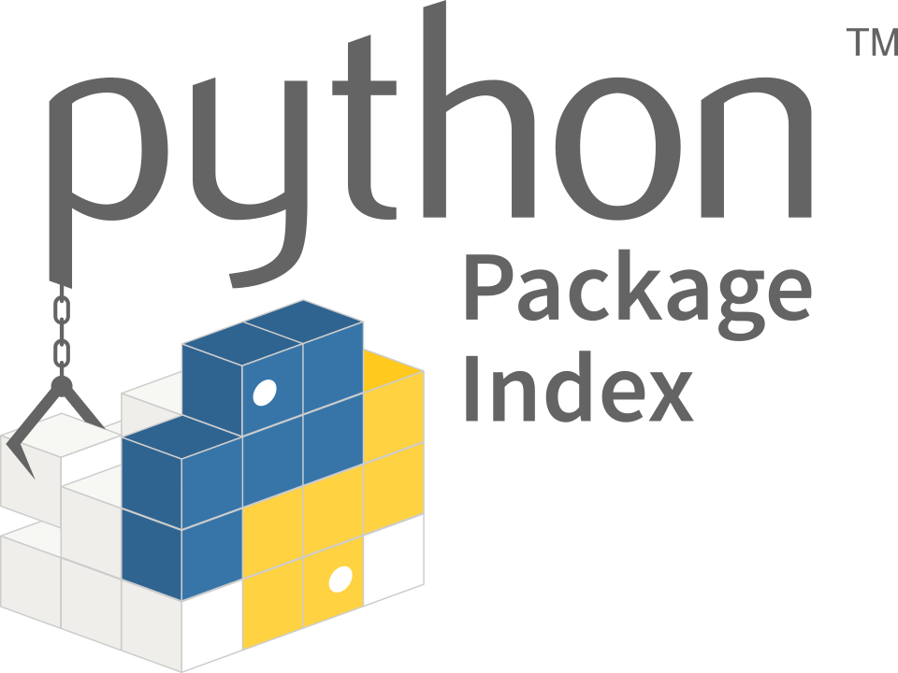



Specialized accounts
https://pypi.org/user/sinalalebakhsh/
https://github.com/sinalalebakhsh
https://stackoverflow.com/users/17351206/sina-laleh-bakhsh

Slide 19
Released packages
https://pypi.org/project/git-auto-django/
https://github.com/sinalalebakhsh/acronproject
https://github.com/sinalalebakhsh/push-py

Slide 20


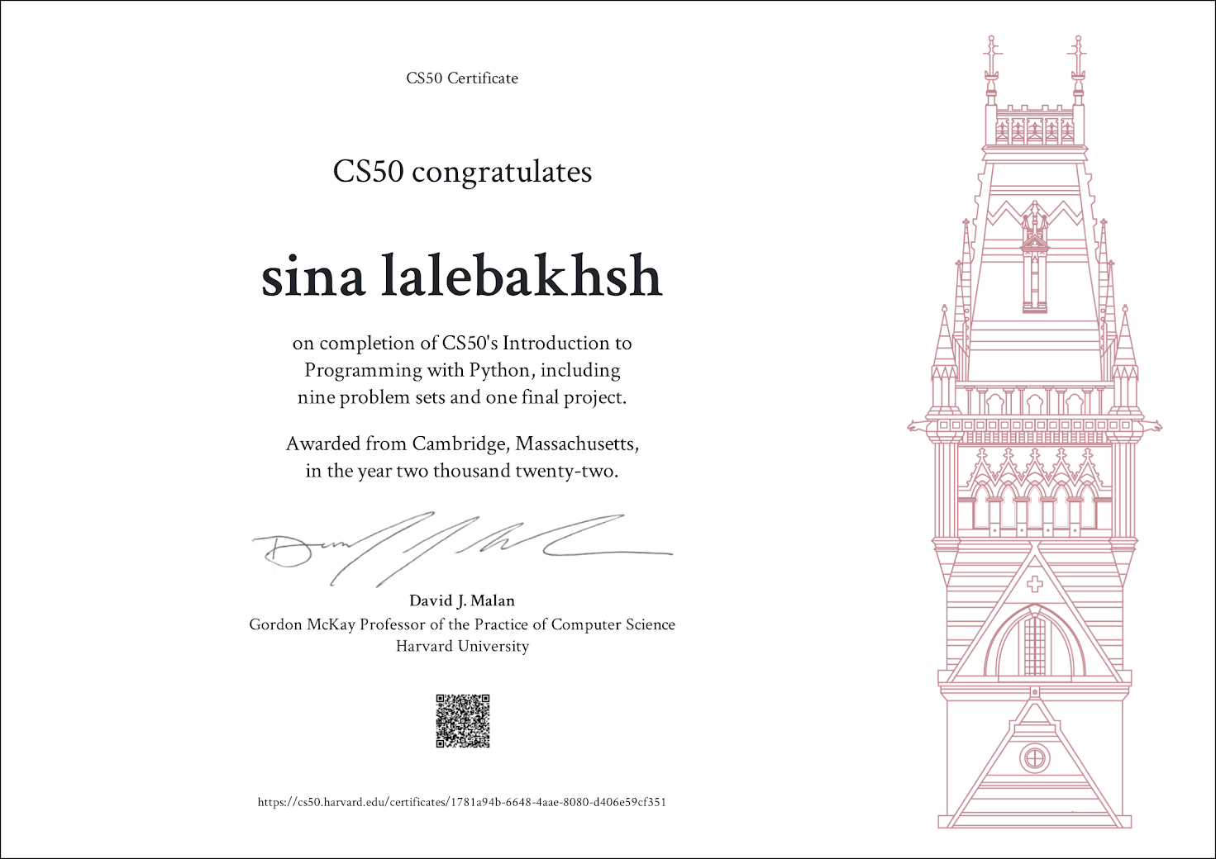
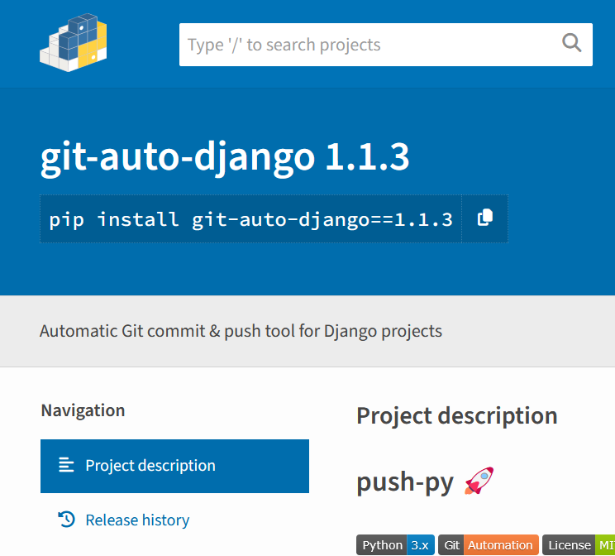
• Foundational Cloud Practitioner – Arvan Academy
• Associate DevOps Engineer – Arvan Academy
• Python Programming – Harvard (EDX)
• Open-source contributor & package publisher on PyPI

Slide 21


Art impact & Creative Background
Background in Visual Communication and graphic design
Practical experience in sculpture and 3D artistic forms
Logo and visual identity design with conceptual focus
Portrait drawing and painting with attention to detail and expression

Slide 22
Education history
2011
Geraphic-Kamalolmolk
2020
Python Harvard EDX.com
2025
Associate DevOps Engineer
2025
Foundational Cloud Practitioner

Slide 23

Connect with me
LinkedIn
https://www.linkedin.com/in/sina-lalebakhsh/
Github
https://github.com/sinalalebakhsh
Email
sinalalehbakhsh@gmail.com
Arvan Academy
https://academy.arvancloud.ir/members/0bbb1ece/

Slide 24
Connect with me
Cellphone
09126507649
WhatsApp
09126507649
Telegram urs:
sinalalebakhsh
BlueSky
https://bsky.app/profile/sinalalebakhsh.bsky.social

Slide 25






Media work (educational content production)
2020 – Now
2025 - now
2023 – Now
https://www.youtube.com/@acronproject
https://t.me/acronproject
https://www.instagram.com/acronproject
Click here …
Click here …
Click here …

Slide 26
I am a backend engineer specialized in Django and FastAPI, with a strong focus onORM optimization, high-performance APIs, asynchronous processing, and scalabledata-driven systems.

Slide 30
Focused on building scalable, secure, and high-performance backend systemswith modern Python technologies and production-ready architecture.
Sina Lalehbakhsh

